Slide 1

Java for Beginners
Level 4
Mr. Teasdale

Slide 2
Let’s review
Show you teacher what you have done for the level 3 tasks
Remember: comment your code as you work through the tasks. This will help develop your understanding of the different concepts as well as what each piece of code does
Wordle.org

Slide 3
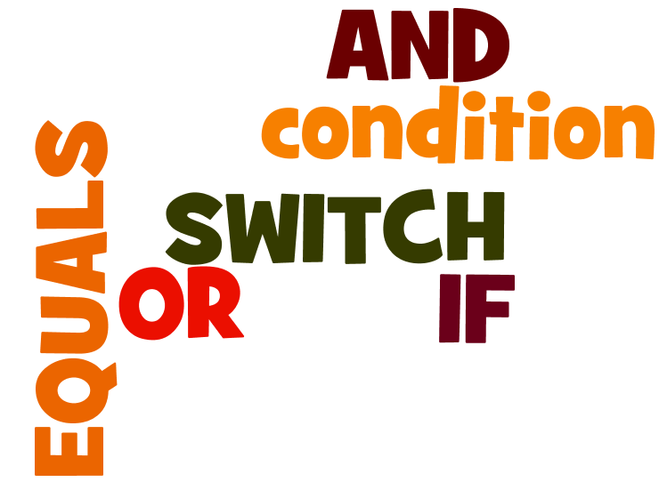
What do you learn last time?
Wordle.org

Slide 4
Levels of Java coding
1: Syntax, laws, variables, output
2: Input, calculations, String manipulation
3: Selection (IF-ELSE)
4: Iteration/Loops (FOR/WHILE)
5: Complex algorithms
6: Arrays
7: File management
8: Methods
9: Objects and classes
10: Graphical user interface elements

Slide 5
if(condition)
Condition is a logic check
something OPERATOR something
Example:
if(num == 3)

Slide 6
Logic operators in Java
Operator | Function | Example
= = | equals (int, double, char, boolean) | if(num==3)
.equals() | equals (String) | if(name.equals(“Chris”) )
> | greater than | if(num>20)
< | less than | if(num<15)
>= | greater than or equal to | if(age>=18)
<= | less than or equal to | if(age<=12)
!= | not equal to | if(married!=true)
Warning! = does not mean ==

Slide 7
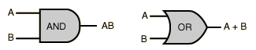
AND/OR
AND in Java: &&
OR in Java: ||
Used between conditions
if(num>3&&<12) ✗
if(num>3)&&(num<12)✓

Slide 8

Types of iteration (loops)
Iteration
Fixed number of times
Unspecified number of times
FOR loop
WHILE loop

Slide 9
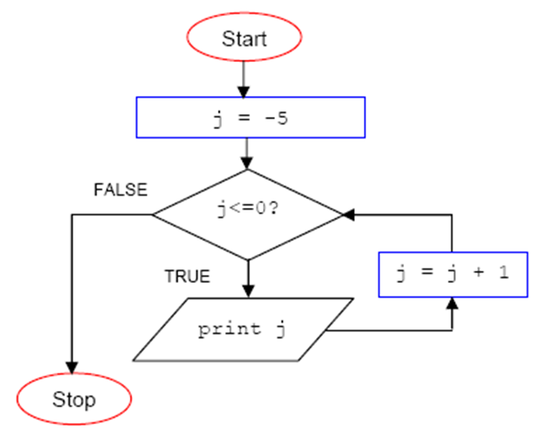
Can you predict the output?

Slide 10

for(counter; condition; change)
A logic condition (like in IF) that has to be true for the loop to continue.
Something Operator Something (usually involving the counter variable)
A simple variable (usually an int) that allows the loop to ‘step through’
Normally called “i”
What should happen to the counter variable value at the end of the loop
Usually i++ or i--

Slide 11
Typical example (FOR loop)
Create int called i
Set i to 0
Continue while i is less than 3
At end of for loop, increase i by 1
for(int i = 0; i<3; i++)
{
System.out.println(“X”);
}
Output
X
X
X

Slide 12
Another example (FOR loop)
Create int called i
Set i to 0
Continue while i is less than 5
At end of for loop, increase i by 1
for(int i = 0; i<5; i++)
{
System.out.println(i);
}
Output
0
1
2
3
4

Slide 13
Predict the outcome (FOR loop)
What is the counter and starting value?
What is the condition?
What change happens?
for(int j = 2; j<10; j=j+2)
{
System.out.println(j);
}
Output
?
2
4
6
8

Slide 14
Students struggle with…
EVERYTHING ABOUT LOOPS
Loops are an abstract construct. Lower ability students will need a LOT of simple practice.
Most common mistake:
for(int i = 0; i<5; i++);

Slide 15
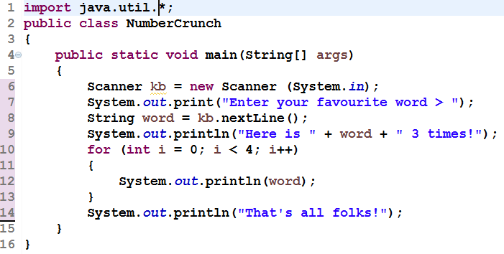
FOR example
Can you spot the mistake?
Output
Enter your favourite word >
Cheese
Here is Cheese 3 times!
Cheese
Cheese
Cheese
Cheese
That’s all folks!

Slide 16
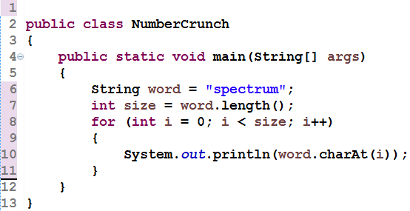
FOR with .charAt(x)
s p e c t r u m
?
Output

Slide 17
Detour: random numbers
It can be very useful to make a random number in program.
Java has a many ways to do this.
Most common way is Math.random()
Note: This is NOT an examinable bit, but it does teach logical thinking which IS examinable.

Slide 18
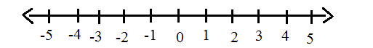
Making random numbers
Math.random() generates a random double number between 0 and 1. e.g. 0.34212… or 0.93813
To make random int numbers between say 1 and 10 (both included), we need to use a bit of maths.

Slide 19
Useful formula:
Min+(int)(Math.random()*((Max - Min) + 1))
Write down the minimum number and maximum number you need, and use the formula!
So let’s make numbers between 1 and 10:
1 +(int)(Math.random()*((10 - 1) + 1))

Slide 20
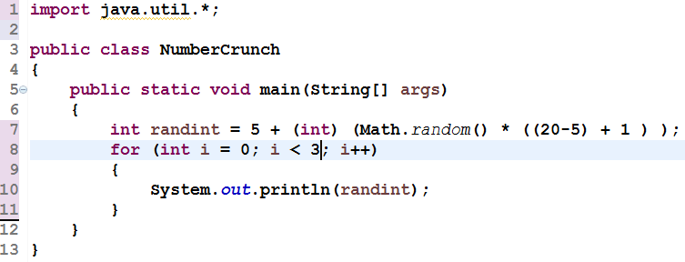
FOR with random ints (A)
?
Output
17
17
17

Slide 21
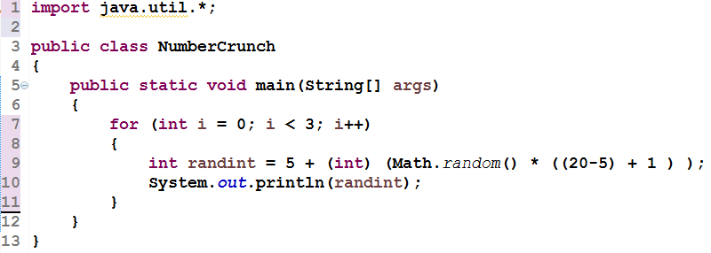
FOR with random ints (B)
?
Output
19
7
12

Slide 22
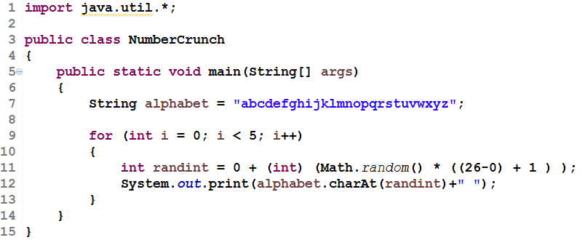
Example task (advanced)
Write a java program that will generate a random letter of the alphabet 5 times.
Example output: g u l x e
?

Slide 23

Over to you…
Now it is your turn.
Complete the tasks in your workbook
Do tasks 1 and 2
Complete extension iif finished

